Slide 1
CMPE 483 Movements Activity
Section: CMPE483-L01
Group members:
1. Munif al-Housani 201605496
2. Zabin Al-Dosari 202009034
3. AbdElaziz Shehata 202107370
4. Sultan al-harami 202103147

Slide 2
Code Logic
To begin with, the robot turns on its camera and waits for two seconds so the camera can warm up. Then, the robot enters a loop where it keeps repeating the same steps over and over. First, it captures a picture using the camera. The picture is converted into HSV color format, which separates each pixel into hue, saturation, and value. This format is better than regular RGB for detecting specific colors especially under different lighting conditions.
Instead of using the full image, the robot focuses only on a cropped area near the bottom, where the line is expected to appear. Then it applies a color thresholding filter using the HSV image. It checks if each pixel falls within a certain HSV range (for example, low brightness for black). An image made of only black and white pixels, where white represents the parts of the image that match the color we want (like the black line), and black is everything else.

Slide 3
Cont.
Next, it uses morphological filters: erosion is applied first to remove small white noise dots, and then dilation is applied to thicken the actual line. This makes the line clearer and easier for the robot to detect. Then the robot looks for shapes (called contours). If it finds any, it picks the biggest one and calculates its center point. By comparing this point to the center of the camera’s view, the robot measures how far it has drifted from the line. This value is called the error.
The robot then uses a PID controller to correct its movement. The controller checks how big the error is now and how fast it’s changing. Based on this, it slightly adjusts the motor speeds making one wheel go faster and the other slower so the robot gently turns back toward the center of the line. If the robot doesn’t see any line at all, it slowly spins in place to search for it again.
Meanwhile, a live video window shows what the robot sees, including the detected line, the calculated error, and any steering corrections. You can press “P” to pause the motors or “Q” to stop the program completely.

Slide 4
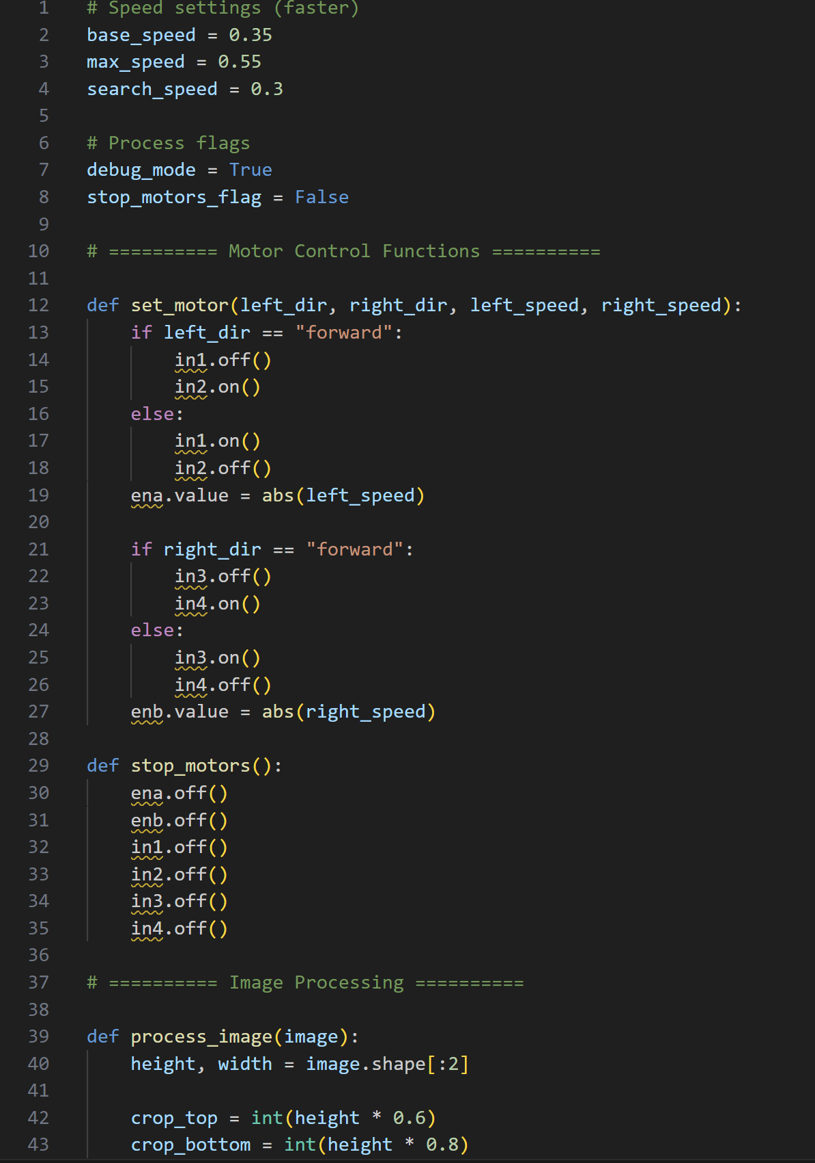
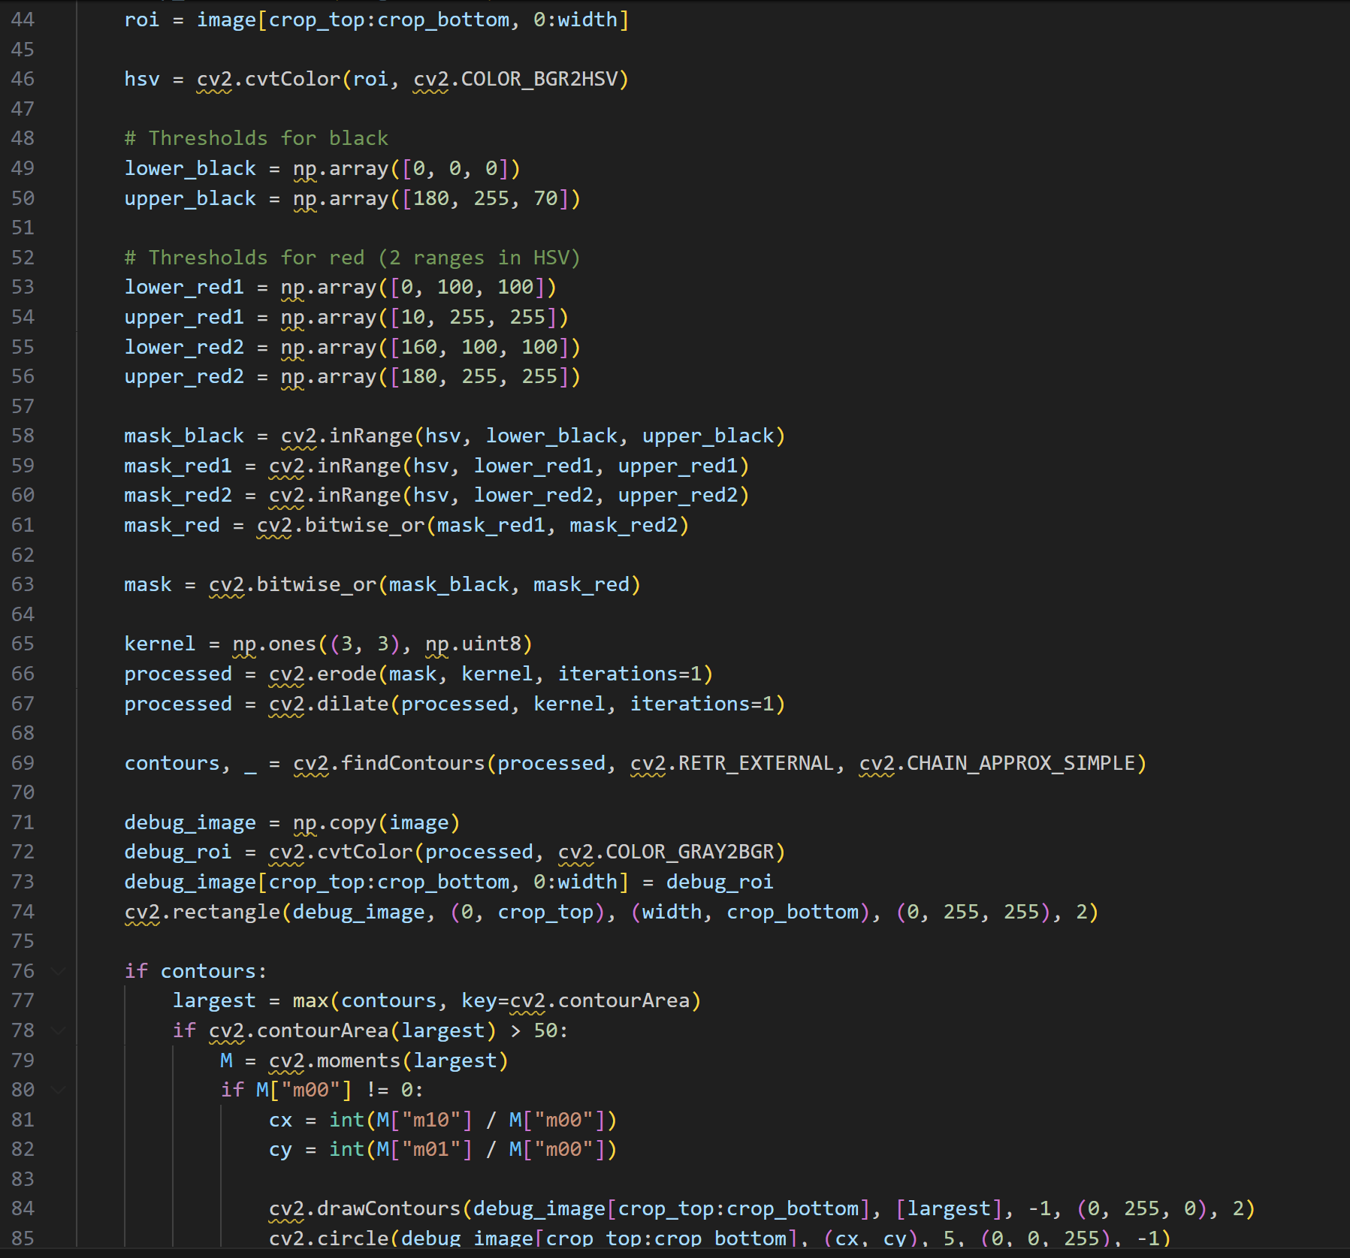
Code

Slide 5
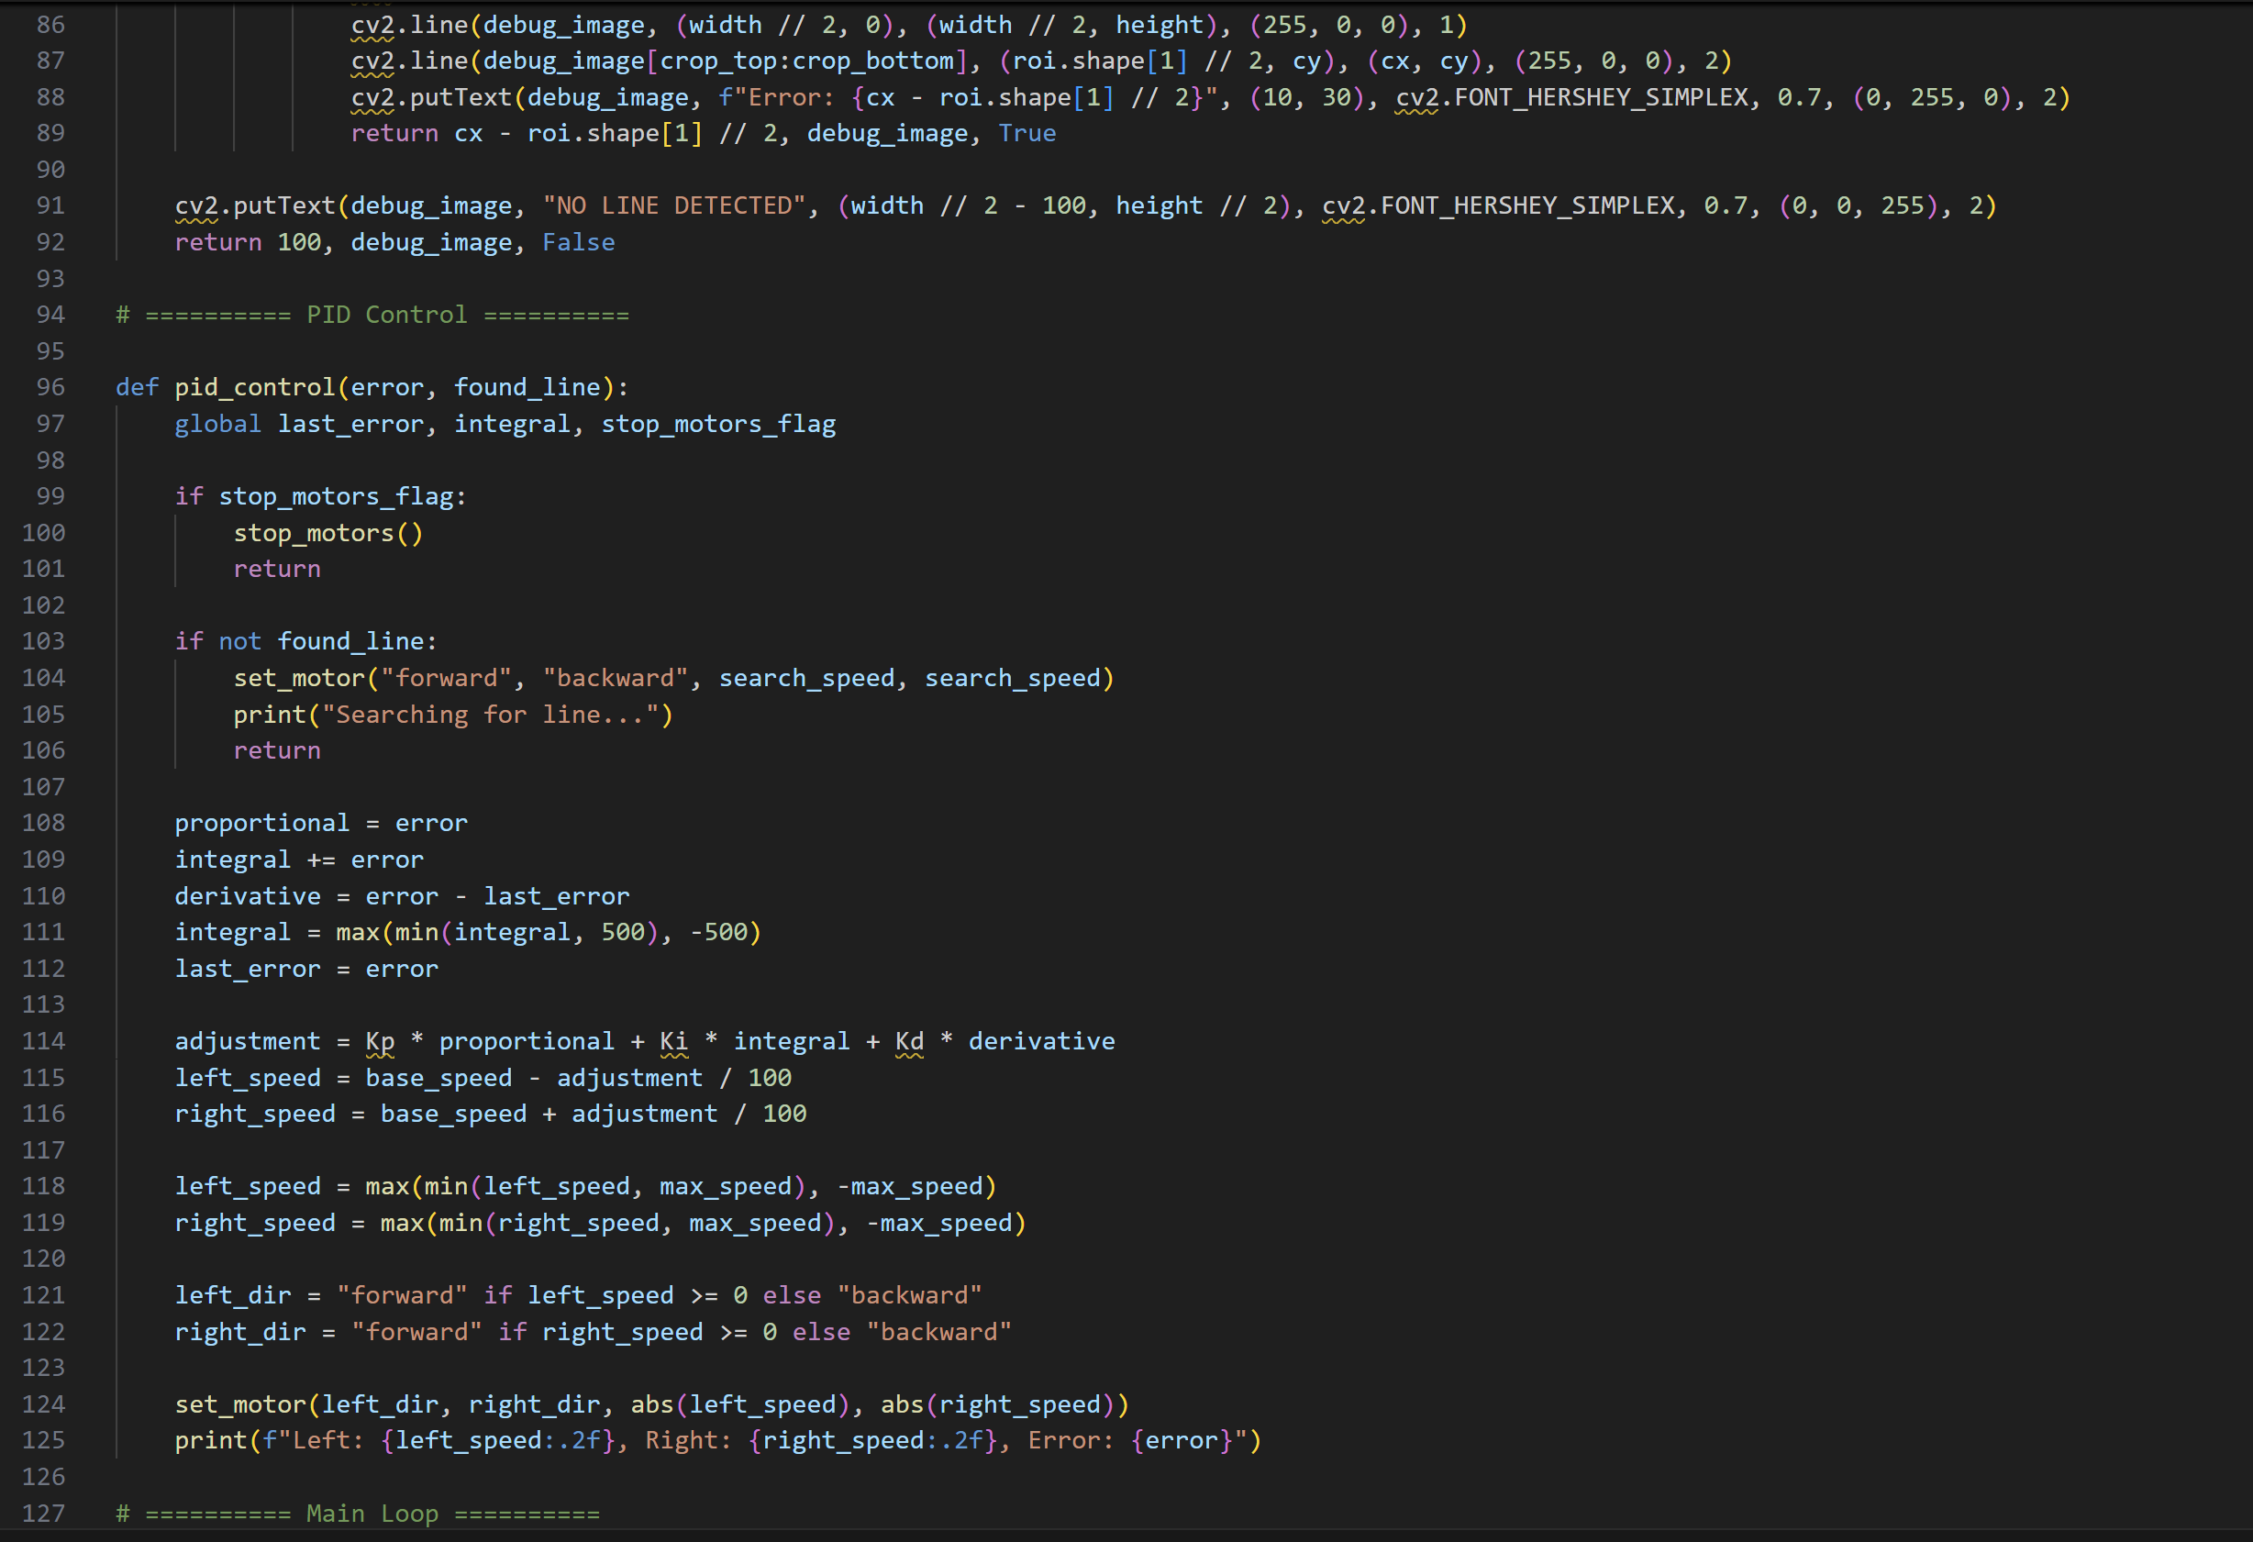
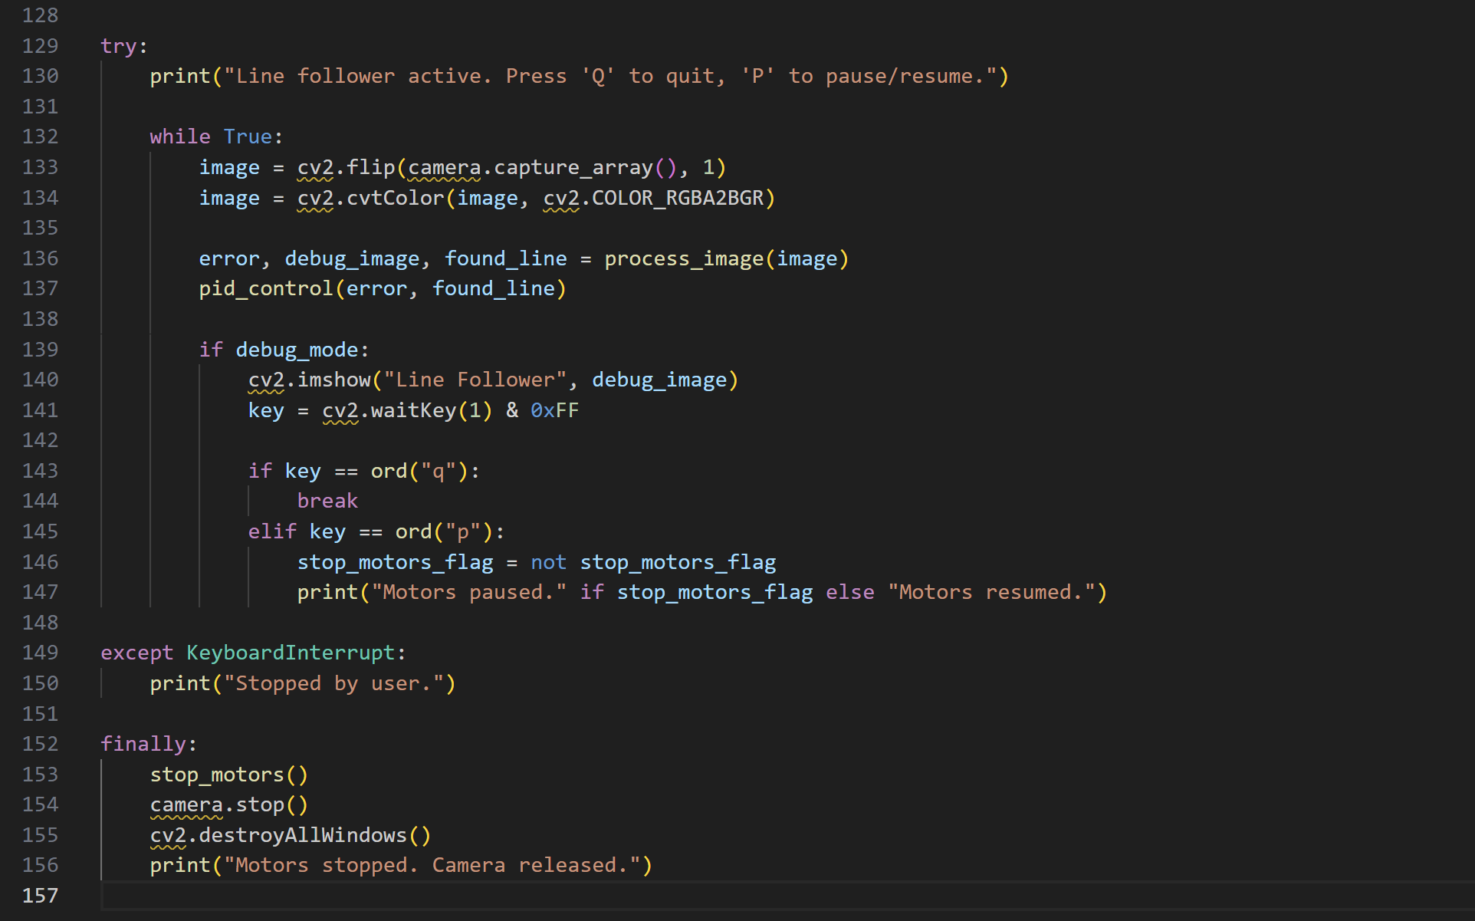

Code

Slide 6
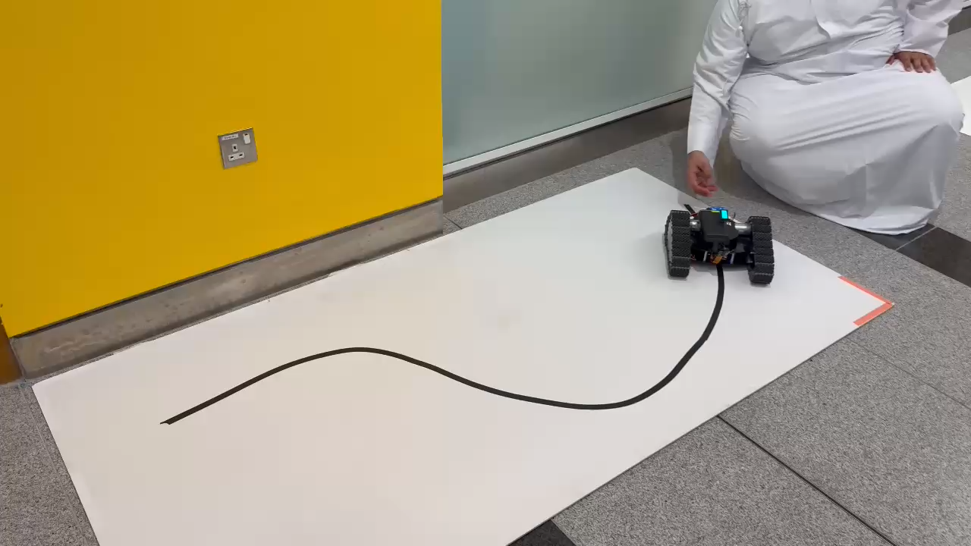
Video

Slide 7
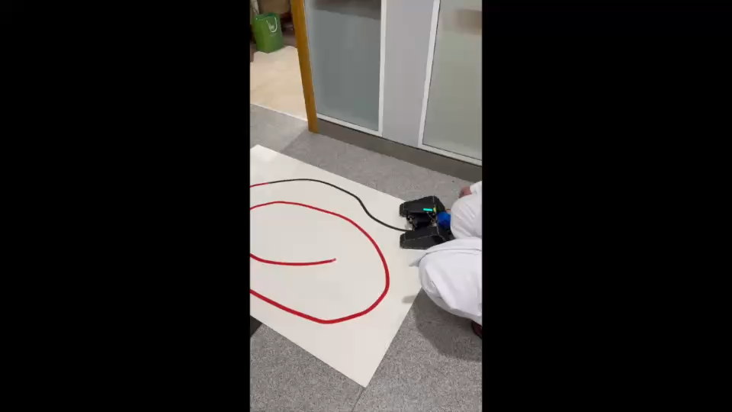
Video

